Slide 1




Yelp Data Set Analysis
CIS 8045: Term Project
Dr. Wael Jabr
Team Members:
Aditya Paliwal
Laurence McNally
Saketh Valiveti

Slide 2
Introduction
Design Yelp’s new webpage for businesses and reviewers
Website should be driven by analytics metrics
Yelp Dataset: https://www.yelp.com/dataset/download
Dataset documentation: https://www.yelp.com/dataset/documentation/main
Tools used:
MongoDB – Data storage, data preparation and querying
Neo4j – Data storage and querying
SAS – Text mining of reviews to detect fake reviews
Tableau – Designing dashboards for businesses and reviewers

Slide 3
Data Overview and Storage
The dataset was obtained from Yelp’s official website
Elements of dataset:
Business.json - Contains business data including location data, attributes, and categories
Review.json - Contains full review text data including the user_id that wrote the review and the business_id the review is written for
User.json - User data including the user's friend mapping and all the metadata associated with the user
Checkin.json - Checkins on a business
Tip.json - Tips written by a user on a business. Tips are shorter than reviews and tend to convey quick suggestions
Photo.json - Contains photo data including the caption and classification (one of "food", "drink", "menu", "inside" or "outside")
Datasets used and stored in MongoDB and Neo4j: Business.json, Review.json, User.json

Slide 4
Data Preparation
Focused on Charlotte, NC and Pittsburgh, PA
Cleaned data in MongoDB
Removed businesses, reviews, users for cities other than Charlotte and Pittsburgh
Converted data into desired datatypes
Fields like date were of string type – converted it to date type for querying
Exported cleaned data in json, csv formats
To use data in Neo4j, SAS and Tableau
Converting data file to csv format using python
Exporting as csv from MongoDB caused formatting issues
Final 3 datasets used:
business.json (16,526 rows)
review.json (534,921 rows)
user.json (163,034 rows)

Slide 5
MongoDB Schema
db.reviewer.insert({
“user_id": “A12345”,
"name": "John Smith",
"since": "1, 1, 2002",
"number_of_friends": 46,
})
db.business.insert({
"business_id":"ABC00123",
"name": "Sam’s Restaurant",
"address": "123 Some St, City, State - 12345",
"related": ["AIU0143"," ADC54123"," ABC00126"],
"dateopened":"3, 9, 2016",
"category": [“Restaurants”,"Mexican Grill"],
"review": [{
"review_id": 1234Z,
"useful": 5,
"funny": 2,
"cool": 6,
"text":"thanks but no thanks",
"rtime":"1, 11, 2012",
"rating":3,
"compliment":[{
"cid": 1234,
"ctitle":"xyz",
"cdate":"5 6, 2012",
"ctext":"thank you"
}]
}]
})
Reviewer Collection
User profile, metrics
Business Collection
Details about the business
Embedded reviews
Embedded compliments

Slide 6
Neo4j Schema
Business
{Business_id: “AX12”, city: “str”, stars: int}
Review
{text: “str”, funny: “str”, cool: “str”}
User
{reviewer_id: “str”, name: “string”}
:REVIEWED_BY
:CREATED_BY
:FRIEND_OF
(BusinessIDs)-[rvd:REVIEWED_BY]->(ReviewIDs)-[crt:CREATED_BY]->(UserIDs)-[frd:FRIEND_OF]->(UserIDs)
Notes:
All Yelp users are included in Users node. This is because any user can post reviews, comments and cast votes regardless of whether they used Yelp as an intermediary or not to obtain certain service.
Yelp essentially allows Users to review their experience with a Business rather than review a specific product like in Amazon. This is because Yelp connects a vast variety of Business to its Users (Food, Home services, Auto services etc). So there is no Product node involved in the schema. This also means that it relies heavily on its User to specify the service/product they used and post the correct images of the same. Yelp later analyzes the reviews to try identify the product.
Business representatives respond to reviews. They thank Users for positive reviews and try compensate Users that were dissatisfied with the service/product and posted a negative review.
Users can vote on reviews. Votes at Yelp are categorized as Useful, Funny or Cool. Users can follow each other

Slide 7
Exploration of the Data : MongoDB
Metrics derived for a business
Current Stars
Histogram of stars
Most recent reviews feed
Most recent poor reviews
No. of reviews
No. of reviewers
Stars of businesses belonging to same category
Trends of stars across time period
Metrics derived for a reviewer
Average Stars given
Histogram of stars
Most recent reviews feed with no of useful, funny and cool votes
Most recent useful review
No. of reviews
No. of categories reviewed
No. of fans
No. of friends
Responses to reviews
Elite Status

Slide 8
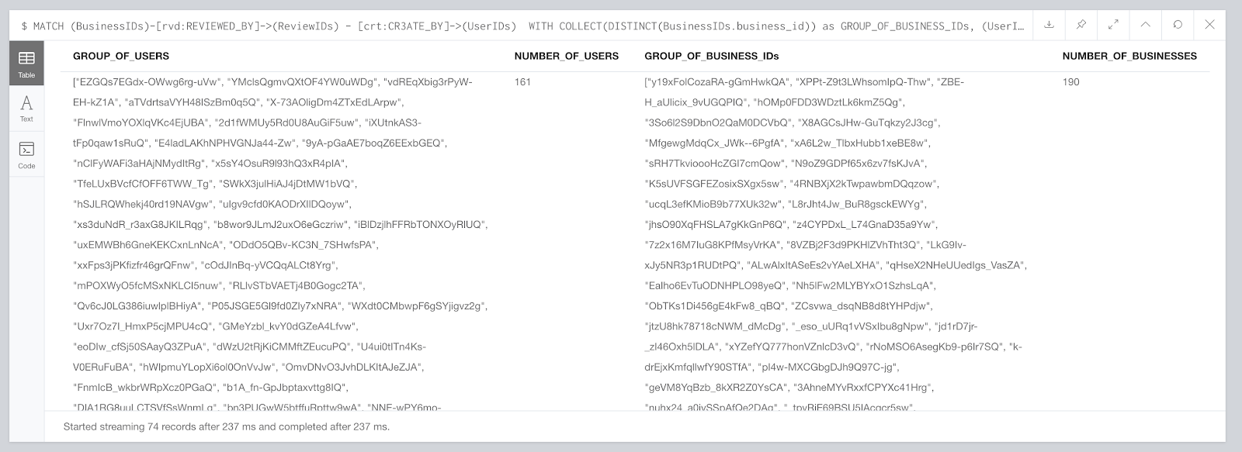
Exploration of the Data : Neo4j
Do Reviewers review in a mob?

Slide 9
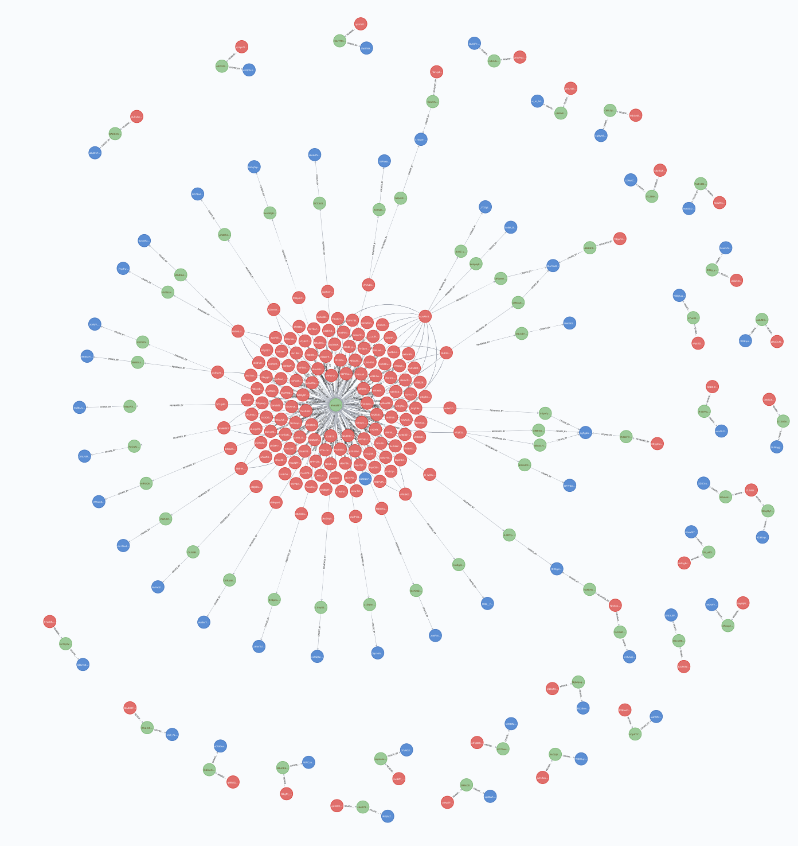
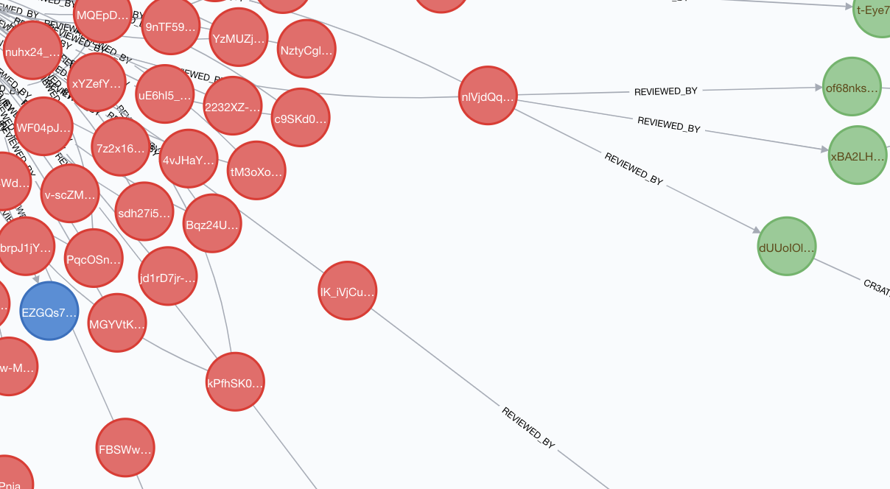
Exploration of the Data : Neo4j
Do Reviewers review in a mob?
Analyzed the table output and interpreted the graph .
Conclude that users do act as a mob in our Dataset

Slide 10
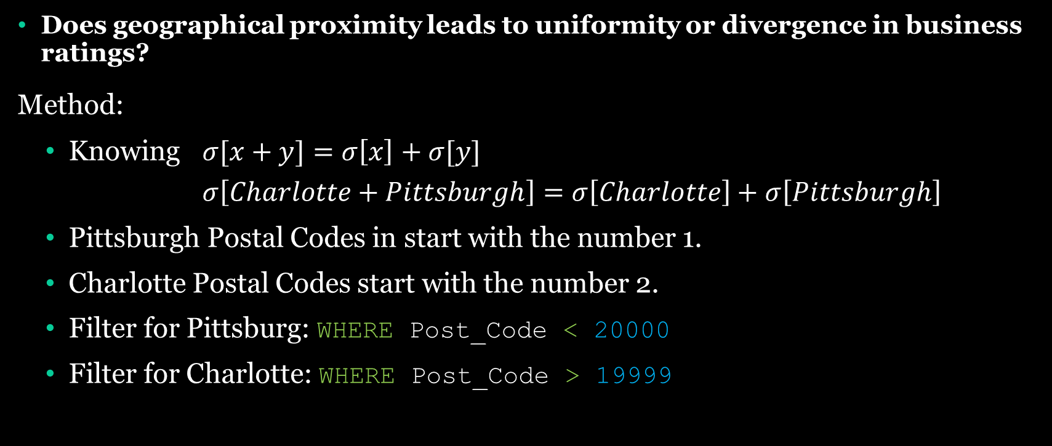
Exploration of the Data : Neo4j
Does geographical proximity leads to uniformity or divergence in business ratings?
Method:
Knowing $σ[x+y]=σ\left[x\right]+σ[y]$
$σ\left[Charlotte+Pittsburgh\right]=σ\left[Charlotte\right]+σ\left[Pittsburgh\right]$
Pittsburgh Postal Codes in start with the number 1.
Charlotte Postal Codes start with the number 2.
Filter for Pittsburg: WHERE Post_Code < 20000
Filter for Charlotte: WHERE Post_Code > 19999

Slide 11
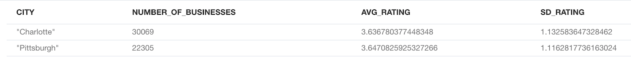
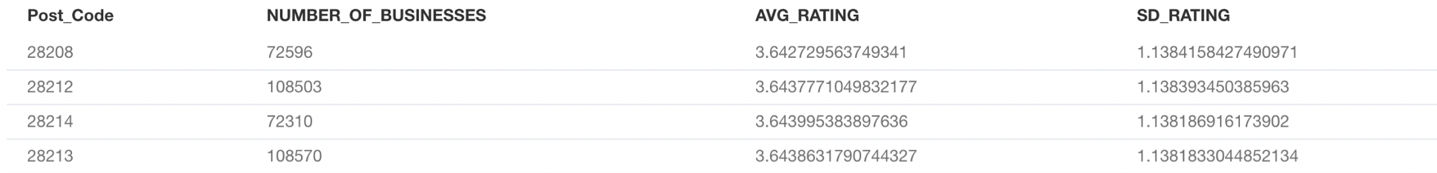
Exploration of the Data : Neo4j
Entire Population
2 Cities
Post Codes in Charlotte

Slide 12
Exploration of the Data : Neo4j
Does geographical proximity leads to uniformity or divergence in business ratings?
Yes
It can be be observed in our data that there is uniformity in business ratings based on locations. However, more statistical analysis will have to be performed to construct a confidence interval.

Slide 13
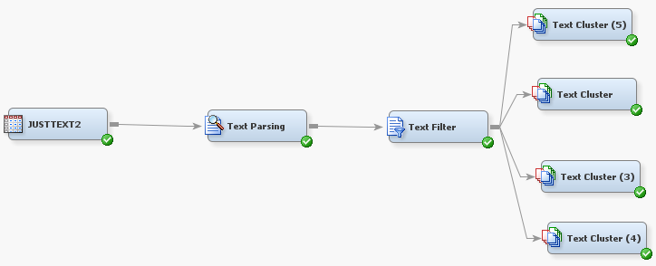
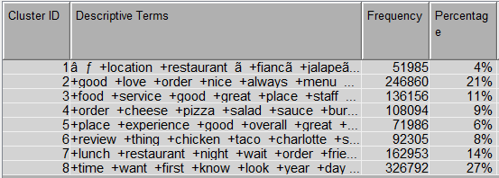
Exploration of the Data : SAS
Identifying fake review by mining the text reviews in SAS
Fake review - a review containing a lot of intense words
“amazing”
“horrible”
“awesome”
Clusters with IDs 3 and 5 show a lot of extreme entries with a frequency of 11% and 6%.
Detection can be improved by also analyzing user behavior, time of reviews etc.

Slide 14
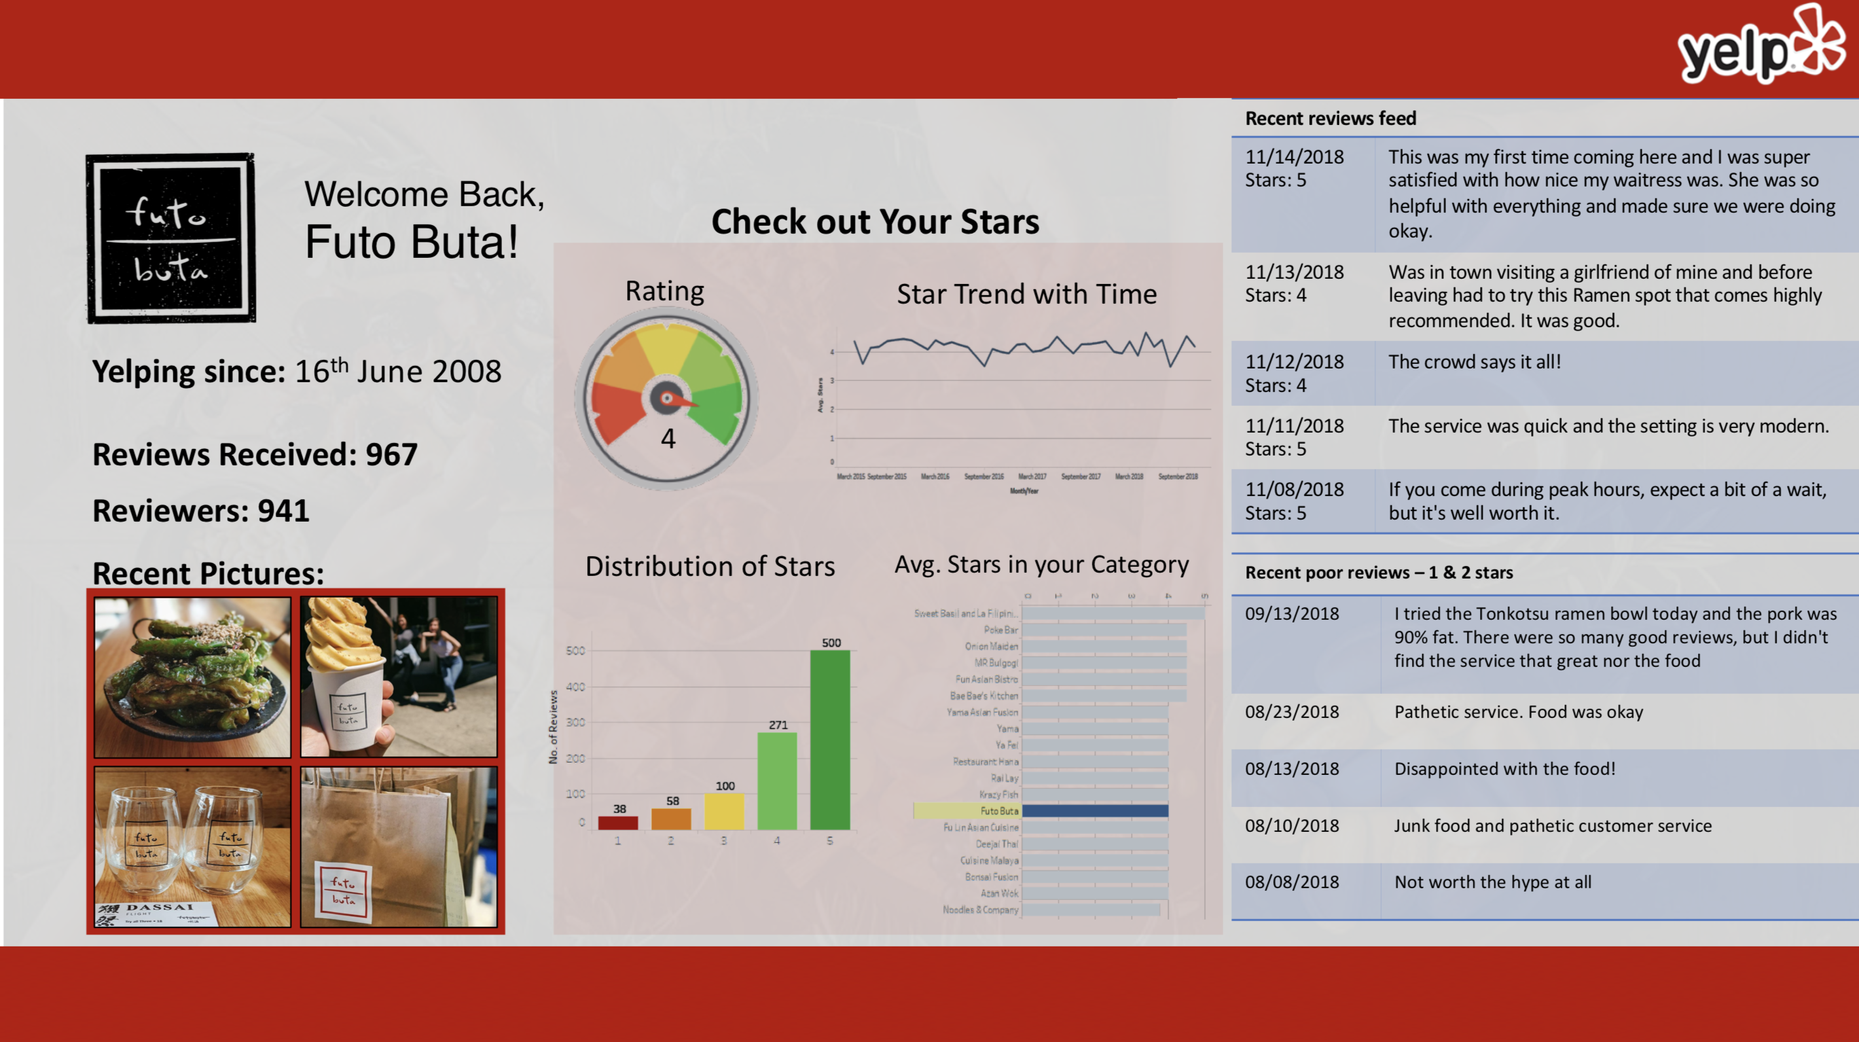

Slide 15
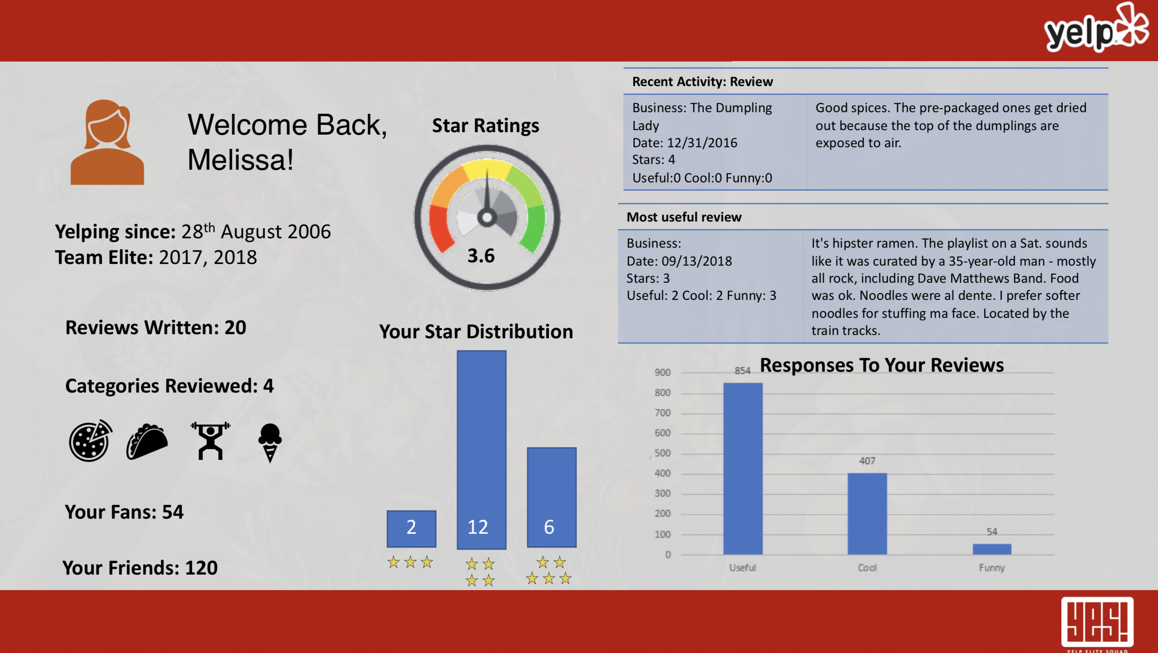

Slide 16
Thank You!

